Slide 1

LEADERSHIP
Certification Program
Level 1
General Conference of Seventh-day Adventists Women’s Ministries Department
www.adventistwomensministries.org

Slide 2
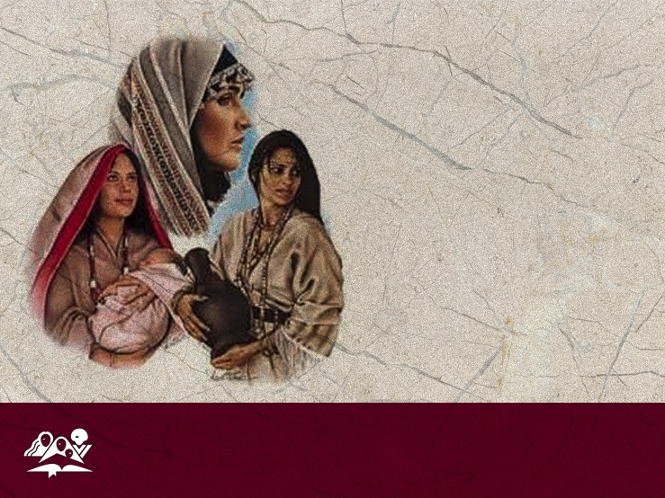
Conditions of Women in Bible Times by Jean Sequeira
Updated by Ardis Stenbakken
(2014)
Leadership Certification Program - Level 1
Notes:
INTRODUCTION
The Original Condition
Women's Ministries involves women from around the world. We come from many countries and language groups. Our customs and cultures are not the same. But the love of Christ unites us with one goal — spreading the Good News that Jesus loves and died for every woman, man, and child on this earth which we call home.
The Bible record covers 1600 years, a number of countries, and a variety of sub-cultures—from that of a tent-dwelling family to the palace of a king. So it is difficult to describe all that was important to women then and to our understanding now.

Slide 3

The Original Condition
"An understanding of the customs of those who lived in Bible times, of the location and time of events, is practical knowledge; for it aids in making clear the figures of the Bible and in bringing out the force of Christ's lessons."
Counsels to Parents, Teachers and Students, p. 518.
Notes:
However, we are told:
"An understanding of the customs of those who lived in Bible times, of the location and time of events, is practical knowledge; for it aids in making clear the figures of the Bible and in bringing out the force of Christ's lessons."
Counsels to Parents, Teachers and Students, p. 518.
To understand Bible women we need to start at the beginning. We all know the story but perhaps have not looked at the significance. Eve, as well as Adam was created in God’s image. “So God created mankind in his own image, in the image of God he created them; male and female he created them” (Genesis 1:27). In his commentary on Genesis, Matthew Henry notes: “If man is the head, she [woman] is the crown, a crown to her husband, the crown of the visible creation. The man was dust refined, but the woman was double-refined, one remove further from the earth…. The woman was made of a rib out of the side of Adam; not made out of his head to rule over him, nor out of his feet to be trampled upon by him, but out of his side to be equal with him, under his arm to be protected, and near his heart to be beloved.”
Genesis 1:28 goes on to say, “God blessed them and said to them, “Be fruitful and increase in number; fill the earth and subdue it. Rule over the fish in the sea and the birds in the sky and over every living creature that moves on the ground.” Physically man and woman were obviously different, but they were given the same work, the same role. They were equal in status. But this did not last long. Sin made its mark quickly with the story of Cain killing Abel, and soon after we have the story of Lamech, the sixth from Adam, a descendent of Cain. “Lamech said to his wives, “Adah and Zillah, listen to me; wives of Lamech, hear my words. I have killed a man for wounding me, a young man for injuring me. If Cain is avenged seven times, then Lamech seventy-seven times” (Genesis 4:23, 24). Whether it was because of general sinfulness, or because they interpreted that Eve was cursed (she was not), woman’s lot in life became difficult.
It may be surprising to us in the twenty-first century, but “the position of women in Israel was in marked contrast with her status in surrounding heathen nations. Israelite law was designed to protect woman’s weakness, safeguard her rights, and preserve her freedom” Later on the influence of the surrounding idolatrous nations continued to contribute to the lowering of the status of women, especially as Israel and Judah began to practice their fertility rites and other abominable practices. So God was working, and we see His hand in the variety of strong women all through both the Old and the New Testaments.

Slide 4

The Original Condition
In New Testament times the status of women had improved slightly as a result of Greek and Roman culture which granted women a few more rights, but it was during this time that we find the famous rabbinic prayer:
Notes:
In New Testament times the status of women had improved slightly as a result of Greek and Roman culture which granted women a few more rights, but it was during this time that we find the famous rabbinic prayer:

Slide 5
The Original Condition
"A man is bound to say the following three blessings daily: '[Blessed art thou...] who hast not made me a heathen,' '...who hast not made me a woman;' and 'who hast not made me a brutish man.'"
Eli Cashdan, Menahoth
(London: The Soncino Press, 1948)
Notes:
"A man is bound to say the following three blessings daily: '[Blessed art thou...] who hast not made me a heathen,' '...who hast not made me a woman;' and 'who hast not made me a brutish man.'" Eli Cashdan, Menahoth (London: The Soncino Press, 1948).

Slide 6
The Original Condition
"Blessed are you, Hashem, King of the Universe, for not having made me a Gentile.” "Blessed are you, Hashem, King of the Universe, for not having made me a slave.” “Blessed are you, Hashem, King of the Universe, for not having made me a woman.” The Complete Artscroll Sidur, Mesorah Publications, Ltd., 1984.
Notes:
Another version of this prayer which originated some 2000 years ago goes like this:
"Blessed are you, Hashem, King of the Universe,
for not having made me a Gentile."
"Blessed are you, Hashem, King of the Universe,
for not having made me a slave."
Blessed are you, Hashem, King of the Universe,
for not having made me a woman. "The Complete Artscroll Sidur Mesorah Publications, Ltd., 1984.
It was really the life and teaching of Jesus that made a difference. He showed total acceptance and respect for all women, and they were greatly drawn to Him.
The individual stories of many Old Testament women will be covered in an excellent seminar in Level 2, so for this seminar we will look at some general conditions for women during Bible times.

Slide 7
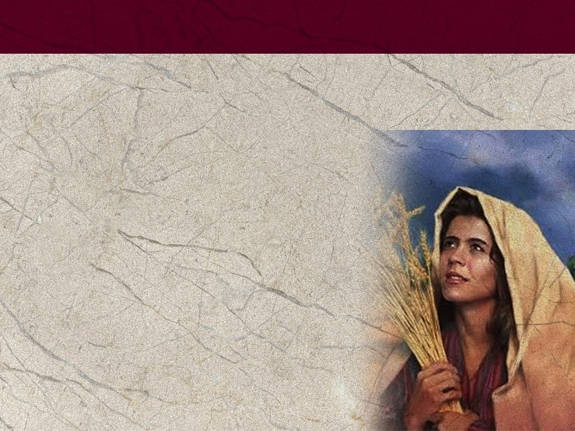
It’s a Girl!
Probably one of the “must” concepts to keep in mind in regard to women in the Bible is the great regard and respect God always showed to them in spite of what might have been expected in their culture.
Notes:
It’s a Girl!
Every couple wanted a boy. When a girl was born, there were already limitations for her.
Probably one of the “must” concepts to keep in mind in regard to women in the Bible is the great regard and respect God always showed to them in spite of what might have been expected in their culture.

Slide 8
It’s a Girl!
One of the prime examples is that of Zelophehad’s daughters. Their story was so important to the Bible writers that it is repeated three times (Numbers 27, 36, and Joshua 17).
Notes:
One of the prime examples is that of Zelophehad’s daughters. Their story was so important to the Bible writers that it is repeated three times (Numbers 27, 36, and Joshua 17).
“The daughters of Zelophehad son of Hepher, the son of Gilead, the son of Makir, the son of Manasseh, belonged to the clans of Manasseh son of Joseph. The names of the daughters were Mahlah, Noah, Hoglah, Milkah and Tirzah. They came forward and stood before Moses, Eleazar the priest, the leaders and the whole assembly at the entrance to the tent of meeting and said, “Our father died in the wilderness. He was not among Korah’s followers, who banded together against the Lord, but he died for his own sin and left no sons. Why should our father’s name disappear from his clan because he had no son? Give us property among our father’s relatives” (Numbers 27:1-4).
This request stumped everyone. Women should receive property? So they wisely went to the Lord. What should they do? It did not seem to be a hard question for God. “What Zelophehad’s daughters are saying is right. You must certainly give them property as an inheritance among their father’s relatives and give their father’s inheritance to them” (verse 7).
The story is repeated again in Joshua 17, but even at that, the tribe worried that if the women married outside the tribe, their property would go to another tribe, so they made the rule that the women must marry within their tribe, which they did.

Slide 9
It’s a Girl!
“So Zelophehad’s daughters did as the Lord commanded Moses. Zelophehad’s daughters—Mahlah, Tirzah, Hoglah, Milkah and Noah—married their cousins on their father’s side. They married within the clans of the descendants of Manasseh son of Joseph, and their inheritance remained in their father’s tribe and clan.”
Numbers 36:10-12
Notes:
“So Zelophehad’s daughters did as the Lord commanded Moses. Zelophehad’s daughters—Mahlah, Tirzah, Hoglah, Milkah and Noah—married their cousins on their father’s side. They married within the clans of the descendants of Manasseh son of Joseph, and their inheritance remained in their father’s tribe and clan” (Numbers 36:10-12).
But beyond being able to inherit property when there were no brothers, women were pretty much considered property themselves. There is a striking picture found in Judges 5:27-30. It is the victory song of Deborah and Barak and Jael over Sisera. Sisera’s mother is wondering why he is taking so long to return.
“The wisest of her ladies answer her;
indeed, she keeps saying to herself,
‘Are they not finding and dividing the spoils:
a woman or two for each man,
colorful garments as plunder for Sisera,
colorful garments embroidered,
highly embroidered garments for my neck—
all this as plunder?”
The women were considered part of the plunder, of equal value with colorful garments. In the story of Ruth, we find Boaz offering property to the unnamed kinsman. Boaz was a noble man who showed that he really cared for Ruth, but he said, “On the day you buy the land from Naomi, you also acquire Ruth the Moabite, the dead man’s widow, in order to maintain the name of the dead with his property” (Ruth 4:5).
Ruth was part of a property exchange.

Slide 10
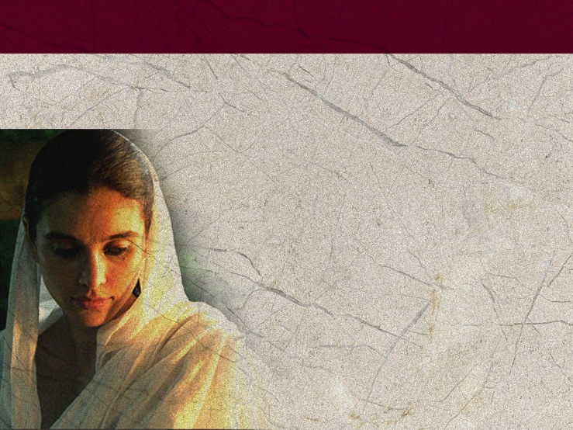
It’s a Girl!
A woman of Bible times was considered property of her father until she married, and then she was the property of her husband. She could not even make a religious vow without their agreement (Num. 30:3-13). Women were really second class citizens.
Notes:
A woman of Bible times was considered property of her father until she married, and then she was the property of her husband. She could not even make a religious vow without their agreement (Numbers 30:3-13). Women were really second class citizens.
One indication of women’s status was the fact that so few of them are named in Scripture compared to men. An example: Noah’s three daughters-in-law. Were women unequal in biblical times by God’s design, or was it a result of culture and the human interpretation of Eve’s sin and curse? It would seem that it was the result of culture and humanity’s sinfulness as time and again we see God trying to protect and uplift women. Even the regulations concerning women found in the book of Leviticus seem strange and sometimes almost barbarian barbaric to us, but compared to the cultures around Israel, God was actually protecting and uplifting women—giving them rights not otherwise available to them.

Slide 11
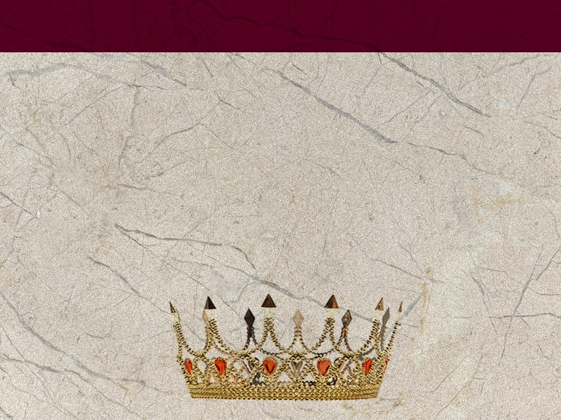
It’s a Girl!
There is one class of women we might be tempted to think had it better: the royal wives. But for the most part to be married to a king or to be part of the royal family brought few privileges and many duties and many disappointments.
Notes:
There is one class of women we might be tempted to think had it better: the royal wives. But for the most part to be married to a king or to be part of the royal family brought few privileges and many duties and many disappointments.

Slide 12
It’s a Girl!
Royal wives were often pawns, given and married for geopolitical reasons, and then soon became a part of a harem. The story of David and Michal is one of the saddest stories regarding royal daughters and wives—David demanded her back from her second husband only for political reasons, not love.
Notes:
Royal wives were often pawns, given and married for geopolitical reasons and then soon became a part of a harem. The story of David and Michal is one of the saddest stories regarding royal daughters and wives—David demanded her back from her second husband only for political reasons, not love.

Slide 13
Marriage (and Divorce) for Everyone
After a girl was betrothed, there was a waiting period, but as we know from the story of Mary and Joseph before the birth of Christ, the engagement period was considered much like being married and could only be broken by adultery. A man was free from military service during this time so he could prepare a home for his bride (Deut. 20:7).
Notes:
Marriage (and Divorce) for Everyone
When a girl reached the age of menstruation, preparations began for her marriage, and until marriage she was expected to keep herself a virgin. Marriages were arranged, and the families would settle on a dowry, which the bride would receive from her parents (Genesis 24:53). The dowry would serve as her share of the family’s inheritance; it was supposed to be used for an “insurance policy” for the woman; in the story of Leah and Rachel they complain about their father, “Not only has he sold us, but he has used up what was paid for us (Genesis 31:15). In the story in Luke 15 of the woman who lost one of her coins, some think that this may have been part of her dowry, or her life savings. These were often worn strung together on the forehead.
After a girl was betrothed, there was a waiting period, but as we know from the story of Mary and Joseph before the birth of Christ, the engagement period was considered much like being married and could only be broken by adultery. A man was free from military service during this time so he could prepare a home for his bride (Deuteronomy 20:7).

Slide 14
Marriage (and Divorce) for Everyone
Rape was considered to be an offense against the father, for it deprived him of the bride price. If a betrothed girl was raped in town, both she and the rapist were to be stoned to death because she did not scream for help.
Notes:
Rape was considered to be an offense against the father, for it deprived him of the bride price. If a betrothed girl was raped in town both she and the rapist were to be stoned to death because she did not scream for help.
If the engaged girl was raped in the country, only the rapist was to be stoned as there would have been no one to hear her scream, and she had committed no wrong. However, if the girl was not engaged to be married: “If a man happens to meet a virgin who is not pledged to be married and rapes her and they are discovered, he shall pay her father fifty shekels of silver. He must marry the young woman, for he has violated her. He can never divorce her as long as he lives” (Deuteronomy 22:28, 29). She is the father’s property, and so he receives the penalty money. In some ways this is similar to or even better than in some countries today where a girl is killed for having been raped, because it is a matter of family honor. However, Exodus 22:16, 17 says, “If a man seduces a virgin who is not pledged to be married and sleeps with her, he must pay the bride-price and she shall be his wife. If her father absolutely refuses to give her to him, he must still pay the bride-price for virgins.”
Again, these laws may seem strange to us in most of the world, but Middle Assyrian law A55 punished a rapist by ordering that the rapist’s own virgin daughter be raped by the father of the victim. God’s way was obviously better.

Slide 15
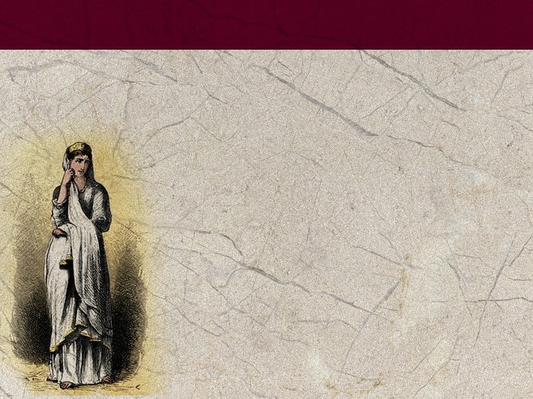
Marriage (and Divorce) for Everyone
The wedding itself was primarily a non-religious ceremony of blessing. The groom and friends went in a procession to the bride’s home to claim her. The bride was veiled and part of the veil was placed on the groom’s shoulder signifying his protection over her.
Notes:
The wedding itself was primarily a non-religious ceremony of blessing. The groom and friends went in a procession to the bride’s home to claim her. The bride was veiled and part of the veil was placed on the groom’s shoulder signifying his protection over her.

Slide 16
Marriage (and Divorce) for Everyone
Then followed a procession to the new home. In the story of Jacob, Rachel, and Leah, we find two other customs: the eldest had to be married first, and the bride was either heavily veiled and/or led to the bridal bed in silence and darkness.
Notes:
Then followed a procession to the new home. In the story of Jacob, Rachel, and Leah, we find two other customs: the eldest had to be married first, and the bride was either heavily veiled and/or led to the bridal bed in silence and darkness.
Then came the marriage and the feasting. The bride’s family supplied the wedding clothes and the feast, and the feast could last for days; to run out of food or wine such as happened at Cana would reflect badly on the bride’s family (John 2). In the story of Jacob, Rachel, and Leah, there was a “bride’s week.”
Just as in many countries today, a young bride had to prove her virginity (Deuteronomy 22:13-21). After the wedding night the blood-stained bed cloth had to be passed around to prove the bride’s chastity. Without that the bride could be stoned to death (Deuteronomy 22:20-21). The fact that the bride had to be a virgin gives new light to the fact that we are to be Christ’s bride, pure and spotless: “I am jealous for you with a godly jealousy. I promised you to one husband to Christ, so that I might present you as a pure virgin to him (2 Corinthians 11:2).

Slide 17

Marriage (and Divorce) for Everyone
The law of Moses allowed for divorce which was very easily obtained by the man—he just had to give her a written statement of divorce (Deut. 24:1, 3; Isa. 50:1; Matt. 5:31). Anything that displeased him could be a basis for this action.
Notes:
The law of Moses allowed for divorce which was very easily obtained by the man—he just had to give her a written statement of divorce (Deuteronomy 24:1, 3; Isaiah 50:1; Matthew 5:31). Anything that displeased him could be a basis for this action.

Slide 18
Marriage (and Divorce) for Everyone
However, if the man falsely accused her of not being a virgin, he could not divorce her; again, the penalty was paid to her father, not her. If the charge was true, she would simply be stoned to death.
Notes:
However, if the man falsely accused her of not being a virgin, he could not divorce her; again, the penalty was paid to her father, not her. If the charge was true, she would simply be stoned to death.
God tolerated divorce but did not approve of it as we can see from Malachi 2:16 and Matthew 19 and Mark 10. Both the man and woman could be stoned for adultery, so the story in which the woman caught in adultery was brought to Christ, the man should have been brought as well (John 8).

Slide 19
Marriage (and Divorce) for Everyone
A man was allowed to marry a captive if he thought she was beautiful. She was taken to his home, there to “have her shave her head, trim her nails and put aside the clothes she was wearing when captured.”
Notes:
A man was allowed to marry a captive if he thought she was beautiful. She was taken to his home, “have her shave her head, trim her nails and put aside the clothes she was wearing when captured.
After she has lived in your house and mourned her father and mother for a full month, then you may go to her and be her husband and she shall be your wife. If you are not pleased with her, let her go wherever she wishes. You must not sell her or treat her as a slave, since you have dishonored her” (Deuteronomy 21:10-14). This may seem barbaric to us, but it was actually a protection for the woman of that period.

Slide 20
What Bible Women Wanted
A woman considered herself a failure if she was unable to produce children. Proverbs 30:15-16 says, “There are three things that are never satisfied, four that never say, ‘Enough!’ the grave, the barren womb…,” and Psalm 113:9 says that the Lord “settles the barren woman in her home, as a happy mother of children.”
Notes:
What Bible Women Wanted
As one reads through the opening stories of the Bible it seems that there were several things mentioned regarding women over and over: that a woman was beautiful (Genesis 6:2, 12:11, 12:14, 24:16, 26:7, 29:17, Deuteronomy 21:11, 1 Samuel 25:3, 2 Samuel 11:2, 13:1, 14:27, 1 Kings 1:3, Esther 2:3 and 7, Job 42:15) or that she was barren. Having children, especially boys, was extremely important— sons would carry on the family name and lineage. And probably every Hebrew girl hoped that she would be given that greatest of all honors, to bear the Messiah.
A woman considered herself a failure if she was unable to produce children. Proverbs 30:15-16 says, “There are three things that are never satisfied, four that never say, ‘Enough! the grave, the barren womb…,” and Psalm 113:9 says that the Lord “settles the barren woman in her home, as a happy mother of children.”
The note on this text in the Zondervan NIV Study Bible (1985) says, “In that ancient society barrenness was for a woman the greatest disgrace and the deepest tragedy (see Genesis 30:1; 1 Samuel 1:6-7, 10) ln her old age she would be as desolate as Naomi because she would have no one to sustain her (see Ruth 1:11-13; see also 2 Ki 4:14).” Rachel became so desperate to have a child that she said, “Give me children, or I’ll die!” (Genesis 30:1).
Why would this be? There was no life insurance, no social security or pension program, and the woman had no money-making options. About the only professions open to women were midwifery or prostitution. This is one of the reasons the entire Bible speaks so often of helping the widow and orphans, and Christ reaches out to prostitutes along with other disenfranchised persons.

Slide 21
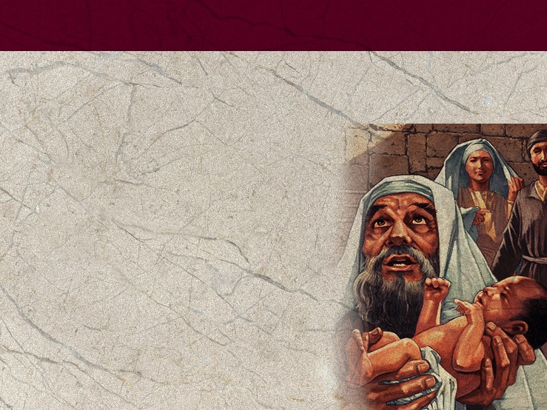
What Bible Women Wanted
Babies were born at home whenever possible; the Egyptians used birthing stools and it may be that the Hebrew women did the same.
Notes:
Birthing and all that pertains to it is factually given in the Bible. A woman’s monthly bleeding was considered unclean (Leviticus 15); thus the woman Jesus healed who was bleeding for 12 years had been considered unclean all during that time and could have no marital relations and everything she touched was considered unclean.
Babies were born at home whenever possible; the Egyptians used birthing stools and it may be that the Hebrew women did the same.

Slide 22
What Bible Women Wanted
In the story of Leah and Rachel, Rachel gives her servant Bilhah as a wife or concubine so that “she can bear children for me and through her I too can build a family” (Gen. 30:3). Some translations and footnotes indicate “for me” as being “on my knees.” Some suggest that this was a physical posture in which the birthing mother was supported on the knees of the adopting woman.
Notes:
In the story of Leah and Rachel, Rachel gives her servant Bilhah as a wife or concubine so that “she can bear children for me and through her I too can build a family” (Genesis 30:3). Some translations and footnotes indicate “for me” as being “on my knees.” Some suggest that this was a physical posture in which the birthing mother was supported on the knees of the adopting woman.

Slide 23
What Bible Women Wanted
Child birth was dangerous as we see in the story of Rachel, and infant mortality was high. When something was painful or bad, the simile “pain like that of a woman in labor” was used. It is used frequently in Jeremiah and Isaiah and other references as well. Jeremiah uses the expression nine times. (see Jeremiah 6:24 and
also 4:31; Isaiah. 13:8; 21:3 and 26:17).
Notes:
Child birth was dangerous as we see in the story of Rachel, and infant mortality was high. When something was painful or bad, the simile “pain like that of a woman in labor” is used frequently in Jeremiah and Isaiah and other references as well (Jeremiah uses the expression nine times (see Jeremiah 6:24 and also 4:31; Isaiah 13:8; 21:3 and 26:17).
Isaiah also speaks of “children come to the moment of birth and there is no strength to deliver them (Isaiah 37:3; this same phrase is found in 2 Kings 19:3). It has been estimated that five percent of first-century women died in childbirth. Isaiah also uses the simile “like a menstrual cloth” as something to throw away as women used rags for menstrual sanitary pads. That gives new meaning to the familiar text, “All of us have become like one who is unclean, and all our righteous acts are like filthy rags” (Isaiah 64:6).
Women were not allowed to bathe during pregnancy for fear of causing a miscarriage. When the baby was born, it was washed, rubbed with salt, water and oil, and wrapped in a tight swaddling cloth for seven days. It was believed this would help limbs to grow straight (Ezekiel. 16:4, Luke 2:7, 14).
Following giving birth, regulations were different for a baby boy or girl: “A woman who becomes pregnant and gives birth to a son will be ceremonially unclean for seven days, just as she is unclean during her monthly period. On the eighth day the boy is to be circumcised. Then the woman must wait thirty-three days to be purified from her bleeding. She must not touch anything sacred or go to the sanctuary until the days of her purification are over. If she gives birth to a daughter, for two weeks the woman will be unclean, as during her period. Then she must wait sixty-six days to be purified from her bleeding” (Leviticus 12:2-5). After her time of uncleanness had passed, she was to bring an offering to the entrance of the Temple/tabernacle. A boy would be named at circumcision but the girl would not be named until she was 14 days old.

Slide 24
What Bible Women Wanted
Mothers in the Bible were greatly respected. We see this by the number of king’s mothers who are named in spite of the fact that nothing else is told about them. An interesting text is “Can a mother forget the baby at her breast and have no compassion on the child she has borne? Though she may forget, I will not forget you!” (Isa. 49:15). God likens Himself to a mother—high praise indeed and one certainly appreciated by the burdened mothers of Bible times.
Notes:
Mothers in the Bible were greatly respected. We see this by the number of king’s mothers who are named in spite of the fact that nothing else is told about them. An interesting text is “Can a mother forget the baby at her breast and have no compassion on the child she has borne? Though she may forget, I will not forget you!” (Isaiah 49:15). God likens Himself to a mother—high praise indeed and one certainly appreciated by the burdened mothers of Bible times.

Slide 25
Polygamy, Wives, and Concubines
Polygamy was a fact of life for the Old Testament woman, and it seldom worked out well for our cast of Bible characters. Take for example Rachel and Leah, Sarah and Hagar, Hannah and Peninnah, David and his five named wives plus other wives and concubines, and certainly Solomon with 700 wives and 300 concubines. God had warned the kings against taking many wives (Deut. 17:17), and instituted safeguards for multiple wives in the laws of Moses (Ex. 21:10).
Notes:
Polygamy, Wives, and Concubines
It did not take long after the ideal of the Garden of Eden that man perverted the divine ideal and purpose in marriage and became a polygamist. The first seems to have been Lamech (of Cain’s family) (Genesis 4:23). Lyland Ryken makes the important observation in the Literary Study Bible, English Standard Version (2007) that the Bible does not commonly make judgments regarding many actions of the Bible characters, but the results speak for themselves—they and we should learn from that. And that was certainly the situation with polygamy.
Polygamy was a fact of life for the Old Testament woman, and it seldom worked out well for our cast of Bible characters. Take for example Rachel and Leah, Sarah and Hagar, Hannah and Peninnah, David and his five named wives plus other wives and concubines, and certainly Solomon with 700 wives and 300 concubines. God had warned the kings against taking many wives (Deuteronomy 17:17), and instituted safeguards for multiple wives in the laws of Moses (Exodus 21:10).
Concubines were common also. Bilah and Zilpah were considered to be concubines; although their children received full rights of inheritance, the women never received the full rights of a wife. One of the most disturbing stories of the Old Testament is the story of the concubine found in Judges 19. The concubine was sent out to be gang raped and abused all night; she died on the threshold. Truly it was a godless period and everyone “did as he saw fit.”
Hagar was a slave, but when Sarah gave her to Abraham she became a wife, not a concubine, but she was still Sarah’s slave and had no choice in anything that happened to her. Abraham had another wife as well: Keturah. The language is not clear if she was concurrent with Sarah or after Sarah’s death.
Polygamy seems to have pretty much disappeared by New Testament times.

Slide 26

Widows, Orphans, and Slaves
Widows and slaves were the most unfortunate class of women in the ancient world, and orphans were usually listed with them. So were prostitutes, as women who had no husband or son often had to turn to prostitution such as we find in the story of Tamar and Judah (Gen. 38).
Notes:
Widows, Orphans, and Slaves
Widows and slaves were the most unfortunate class of women in the ancient world, and orphans were usually listed with them. So were prostitutes, as women who had no husband or son often had to turn to prostitution such as we find in the story of Tamar and Judah (Genesis 38).
A widow, who had to wear distinctive garb—Tamar removed her widow’s clothes before she ensnared Judah and then put them back on again (Genesis 38:14 and 19), not only had no husband, she had no protector unless she had sons to care for her. Thus Naomi was desolate. And we see references to no protection when Boaz tells Ruth, “I have told the men not to lay a hand on you” (Ruth 2:9), and when Ruth tells Naomi where she had been gleaning, Naomi says, ““It will be good for you, my daughter, to go with the women who work for him, because in someone else’s field you might be harmed” (Ruth 2:22). Neither of them had a husband or son to protect her so she was totally vulnerable. When Christ resurrected the widow of Nain He understood the importance of her son to her (Luke 7:11, 12).

Slide 27
Widows, Orphans, and Slaves
Exodus 22:22 cautioned, “Do not take advantage of a widow or an orphan.” There are dozens and dozens of texts mandating care of the widows and even more condemning Israel and Judah and the surrounding countries for their lack of care of widows and orphans. Jesus reached out to widows such as the Widow of Nain and the widow who gave all she had, and other women who may have been widows.
Notes:
Exodus 22:22 cautioned, “Do not take advantage of a widow or an orphan.” There are dozens and dozens of texts mandating care of the widows and even more condemning Israel and Judah and the surrounding countries for their lack of care of widows and orphans. Jesus reached out to widows such as the Widow of Nain and the widow who gave all she had, and other women who may have been widows.
One of the more interesting biblical laws that we find mentioned many times is what is called the Levirate law; it is found in Deuteronomy 25: “If brothers are living together and one of them dies without a son, his widow must not marry outside the family. Her husband’s brother shall take her and marry her and fulfill the duty of a brother-in-law to her. The first son she bears shall carry on the name of the dead brother so that his name will not be blotted out from Israel.” Keeping one’s name was extremely important, which is one of the reasons there are so many genealogies in the Bible, including the two for Jesus Christ, one going back from Mary and one from Joseph. The Leverite law was the governing force in the story of Judah and Tamar and the foundation for the book of Ruth. Deuteronomy 25:7 and following continues with instructions as to what was to happen to the man who didn’t want to marry his sister-in-law. “However, if a man does not want to marry his brother’s wife, she shall go to the elders at the town gate and say, ‘My husband’s brother refuses to carry on his brother’s name in Israel. He will not fulfill the duty of a brother-in-law to me.’ Then the elders of his town shall summon him and talk to him. If he persists in saying, ‘I do not want to marry her,’ his brother’s widow shall go up to him in the presence of the elders, take off one of his sandals, spit in his face and say, ‘This is what is done to the man who will not build up his brother’s family line.’ That man’s line shall be known in Israel as The Family of the Unsandaled.” So there was some justice for the woman after all.
Some well-known widows in Scripture were Anna (Luke 2:36), the Widow of Zarephath, the widow of Nain (Luke 7), the persistent widow (Luke 18:1), and the prophet’s widow whom Elijah helped in 2 Kings 4:1. And some of the slaves/servants you may remember are Rhoda (Acts in Acts 12 and Naaman’s wife’s servant.
It was the conflict and the need to provide for the widows that caused the division among the believers in Jerusalem and the resulting selection of the first seven deacons (Acts 6). In the Old Testament God often reprimanded Israel for not taking care of the widows, but in the Christian era, this was one of the first issues addressed. Paul reminds the people to care for the widows if they are unable to care for themselves (1 Timothy 5:3).

Slide 28
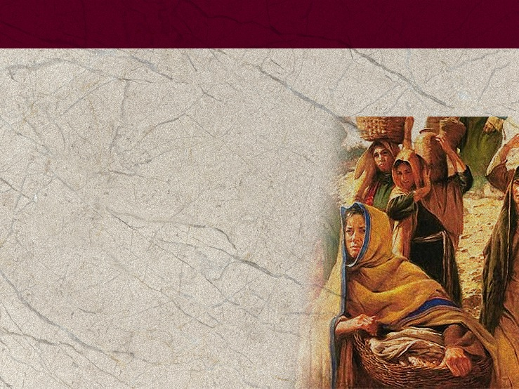
A Woman’s Work is Never Done
Despite the fact that women had little power outside the home, she had a great deal of authority in the home. Most things used in the home were “homemade” and the woman was responsible for most of them.
Notes:
A Woman’s Work Is Never Done
Despite the fact that women had little power outside the home, she had a great deal of authority in the home. Most things used in the home were “homemade” and the woman was responsible for most of them.

Slide 29
A Woman’s Work is Never Done
First there was the matter of clothing. The women, especially the young girls, were shepherdesses as well as the men. We see examples of this in the stories of Rachel and Zipporah.
Notes:
First there was the matter of clothing. The women, especially the young girls, were shepherdesses as well as the men. We see examples of this in the stories of Rachel and Zipporah.
Then they had to card and spin the wool and weave the fabric. Sometimes the woman of the house had servants, sometimes slaves, and often extended family to help with all this. Then there was the actual making of the clothes, such as the little robes Hannah made each year for Samuel.
There was some commerce in fabric as we find in Ezekiel 27:7 and 16: “Fine embroidered linen from Egypt was your sail and served as your banner; your awnings were of blue and purple from the coasts of Elishah. Aram did business with you because of your many products; they exchanged turquoise, purple fabric, embroidered work, fine linen, coral and rubies for your merchandise.”

Slide 30
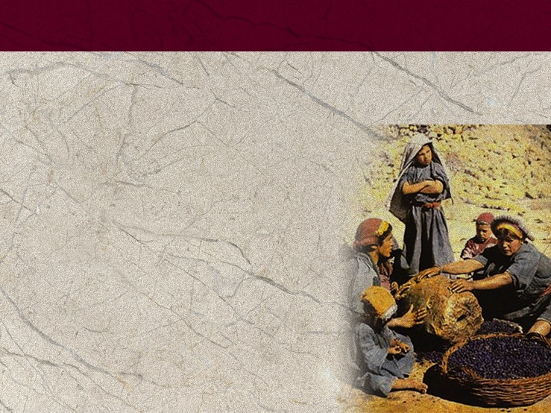
A Woman’s Work Is Never Done
The women were also responsible for preparing
the food; this might begin in the harvest field, especially the grinding of the grain,
such as the mention we find
in Matthew 24:41.
Notes:
The women were also responsible for the preparation of food; this might begin in the harvest field (see Ruth 2), especially the grinding of the grain such as we find in Matthew 24:41.

Slide 31
A Woman’s Work is Never Done
“Two women will be grinding with a hand mill; one will be taken
and the other left.”
Matthew 24:41
Notes:
“Two women will be grinding with a hand mill; one will be taken and the other left.” Matthew 24:41
It was an insult for men to have to grind grain as we find in the story of Sampson (from Judges 16:21).
Isaiah, in likening Israel to a woman, writes, “Take millstones and grind flour; take off your veil. Lift up your skirts, bare your legs, and wade through the streams. Your nakedness will be exposed and your shame uncovered.” And remember the story of Mary and Martha in Luke 10:38-41.

Slide 32
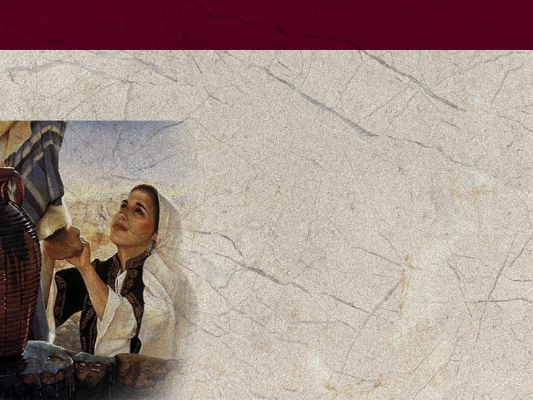
A Woman’s Work is Never Done
Another “woman’s job” was drawing water. In the story of Isaac and Rebecca, Genesis 24:11 tells us, “It was toward evening, the time the women go out to draw water.”
Notes:
Another “woman’s job” was drawing water. In the story of Isaac and Rebecca, Genesis 24:11 tells us, “it was toward evening, the time the women go out to draw water.”
Scripture has many examples of women drawing water, such as the Samaritan woman (John 4). In Mark 14:13, when the disciples are to set up the place for observing Passover, Jesus tells the disciples, “Go into the city, and a man carrying a jar of water will meet you. Follow him.” It was very unusual to find a man carrying water, so this was a certain sign.

Slide 33
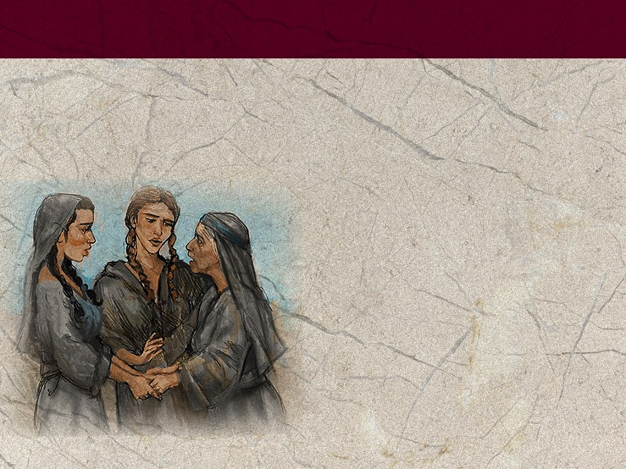
A Woman’s Work is Never Done
Another responsibility of a woman was to act as hostess; being a hostess was different than it is now. One task was to wash the feet of the visitor.
Notes:
Another responsibility of a woman was to act as hostess; being a hostess was different than it is now. One task was to wash the feet of the visitor.

Slide 34
A Woman’s Work is Never Done
It makes one wonder what would have happened in the upper room at the time of the Last Supper if women had been present. The women did not eat with the guests if the guests were men—the women ate in the women’s tent.
Notes:
It makes one wonder what would have happened in the upper room at the time of the Last Supper if women had been present. The women did not eat with the guests if the guests were men—the women ate in the women’s tent.

Slide 35
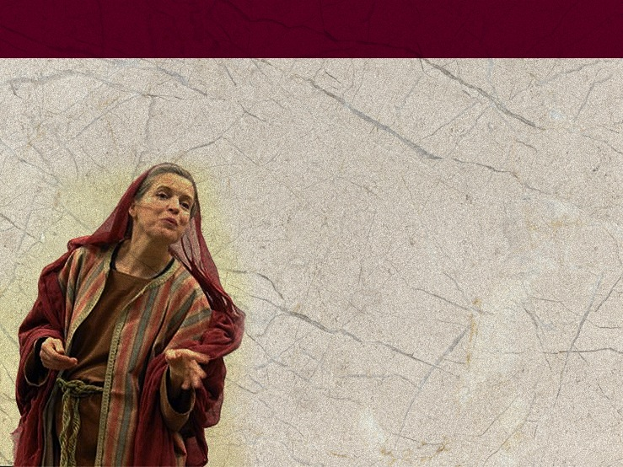
A Woman’s Work Is Never Done
Other “work” in addition to home duties of Bible women included being a political leader, as surprising as that may be, but there was Athaliah, (2 Kings 11) and Jezebel (1 Kings 21), as well as Esther and Deborah (Judges 4 and 5). Women also were involved in business: Lydia (Acts 16), Priscilla (Acts 18), and Sapphira (Acts 5).
Notes:
Other “work” in addition to home duties of Bible women included being a political leader, as surprising as that may be, but there was Athaliah, (2 Kings 11) and Jezebel (1 Kings 21), as well as Esther and Deborah (Judges 4 and 5). Women were involved in business: Lydia (Acts 16), Priscilla (Acts 18), and Sapphira (Acts 5).

Slide 36
A Woman’s Work Is Never Done
And in ministry: Hulda (2 Chron. 34), Junia (Rom. 16:7), Phoebe (Rom. 16:1), Priscilla (Acts 18), the Samaritan woman (John 4), and Tabitha or Dorcas (Acts 9:36-43). And some served as prophetesses; these will be listed later. And of course there were the prostitutes; was Rahab a prostitute or an inn keeper? The authorities don’t know. And slaves: Naaman’s wife’s slave girl and the slave girl who followed Paul and Silas (Acts 16:16-21) among others.
Notes:
And in ministry: Hulda (2 Chronicles 34), Junia (Rom. 16:7), Phoebe (Rom. 16:1), Priscilla (Acts 18), the Samaritan woman (John 4), and Tabitha or Dorcas (Acts 9:36-43). And some served as a prophetess; these will be listed later. And of course there were the prostitutes; was Rahab a prostitute or an inn keeper? The authorities don’t know. And slaves: Naaman’s wife’s slave girl and the slave girl who followed Paul and Silas (Acts 16:16-21) among others.
Thinking of the woman of Proverbs 31 we find a Bible woman who wove wool and flax, was involved in international trade, provided food for her family while directing the servant girls, bought and sold land and planted a vineyard, was a hostess and philanthropist, made clothing for sale—and was a great wife and mother on top of that.
Another task women often did was wail—a part of the culture in which wailing for death or other crisis was common. In the story of Jairus’s daughter being resurrected we find the wailers already at his home. Jeremiah 9:17 records, “This is what the Lord Almighty says: ‘Consider now! Call for the wailing women to come; send for the most skillful of them’.”

Slide 37
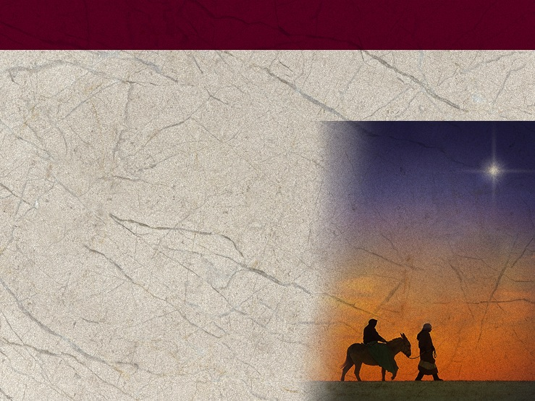
A Woman’s Work is Never Done
In spite of that, whenever the Bible wife went out with her husband, culture indicates that she walked beside their donkey, while he rode, unlike the Christmas cards showing Mary riding and Joseph walking.
Notes:
In spite of that, whenever the Bible wife went out with her husband, culture indicates that she walked beside their donkey, while he rode, unlike the Christmas cards showing Mary riding and Joseph walking.

Slide 38
At the Temple
The Hebrew women did not go to the temple often; the men were required to attend certain temple/tabernacle services each year, but the women were not; they were exempted but not excluded.
Notes:
At the Temple
The Hebrew women did not go to the temple often; the men were required to attend certain temple/tabernacle services each year, but the women were not; they were exempted but not excluded. Perhaps women were excused because of the difficulty of travel with small children and just the logistics. While a woman was unclean from her monthly cycle, pregnancy, or childbirth, she was unable to partake in any temple services. As noted earlier, following the birth of a son she must wait 40 days, or wait 80 days following the birth of a girl. Following births, the mother was to offer sin offerings, differing depending on the gender of the child born.
There were many women who were known for their spiritual or religious story although not very many of them would be called religious leaders. These women would of course include Mary, the mother of Jesus. Others would include Hannah, known for her prayer; Mary Magdalene who was first to proclaim the risen Savior, the women who traveled and ministered with Jesus and his disciples (Luke 8:1-3), Lydia, who apparently hosted the Philippi church in her home (Acts 16), Priscilla who worked with her husband and Paul in spreading the gospel (Acts 18), and the women mentioned in Romans 16. There were also women prophets: Miriam (Exodus. 15:20), Anna (Luke 2:37, 38), Deborah (Judges 4), Hulda (2 Chronicles 34), Isaiah’s wife (Isaiah 8:3), and Philip’s daughters (Acts 21:9), and others. And 1 Corinthians 11:5, 6 says, “But every woman who prays or prophesies with her head uncovered dishonors her head….
There were no women priests (they would often be ceremonially unclean), but there were women who served at the door of the temple. The bronze basin and its bronze stand were made from the mirrors of the women who served at the entrance to the tent of meeting (Exodus 38:8). We do not know exactly what they did, but there were many tasks associated with the services that they may have done such as cleaning, baking the bread, and such. There is no condemnation for this service and Deuteronomy 23:17 states plainly that, “No Israelite man or woman is to become a shrine prostitute.” However, these women are mentioned again in 1 Samuel 2:22: “Now Eli, who was very old, heard about everything his sons were doing to all Israel and how they slept with the women who served at the entrance to the tent of meeting.” Perhaps Israel had degenerated to the point that some of these women were prostitutes, but it is more likely, considering Eli’s sons, that they were just taking advantage of these women who were vulnerable.

Slide 39
At the Temple
Modern observant Jewish women light the Shabbat candles 18 minutes before the Sabbath begins, but there is no biblical injunction to do this even though it is a very nice ritual. Perhaps it started because they were not to light a fire on Sabbath and so they lit candles before the Sabbath.
Notes:
Modern observant Jewish women light the Shabbat candles 18 minutes before the Sabbath begins, but there is not biblical injunction to do this even though it is a very nice ritual. Perhaps it started because they were not to light a fire on Sabbath and so they lit candles before the Sabbath.

Slide 40
At the Temple
Jewish tradition says it began with Sarah as a miracle that lasted from Friday to Friday. The Jewish woman undoubtedly looked forward to the Sabbath as the Sabbath commandment specifically protected women from work on the Sabbath just as it did men.
Notes:
Jewish tradition says it began with Sarah as a miracle that lasted from Friday to Friday. The Jewish woman undoubtedly looked forward to the Sabbath as the Sabbath commandment specifically protected women from work on the Sabbath just as it did men.

Slide 41
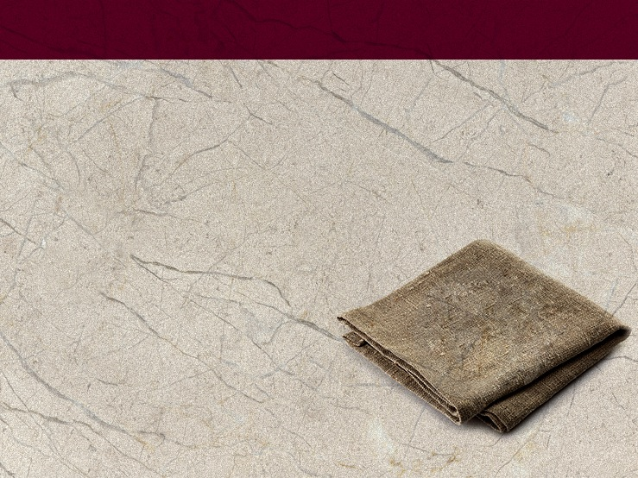
What to Wear
Wool and linen were the most common clothing fabrics. The Egyptians were known for their fine linen clothing, and the Israelites no doubt learned how to make the fine fabric.
Notes:
What to Wear
Ever since Eve left the Garden the question has been what to wear. Because all fabric had to be made by hand, clothing was precious. Garments were prized; examples: Naaman’s offered gift of clothing in 2 Kings 5 and the outfits stolen by Achan (Judges 7). Between Old and New Testament times the styles varied little, but the difference between the clothing of the rich and the poor was obvious. Women were forbidden to wear the same form of clothing as men (Deuteronomy 22:5); however, it was a similar basic pattern but differentiated by embossing, embroidery, and needlework. The women’s “dress” was longer—it reached the ankles. And the headdress was different. The undergarments were fashioned out of cotton, linen, or silk depending on wealth and position. Both genders wore a type of loin cloth wrapped around the body and between the legs and tucked in.
The poorer classes usually went barefoot or wore sandals, although there are pictures that show some women wearing a type of boot. Women often wore a large square of cloth as sort of shawl which could also be used as a blanket. Sometimes, out of modesty, unmarried Hebrew women wore a veil across their face such as Rebecca did when she first met Isaac (Genesis 24:65).
Wool and linen were the most common clothing fabrics. The Egyptians were known for their fine linen clothing, and the Israelites no doubt learned how to make the fine fabric.

Slide 42
What to Wear
The laws of Moses said they were not to weave wool and linen together (Deut. 22:11) or to wear them together. One aspect of clothing that is mentioned in the Bible and often seen in pictures and engravings is that their cloaks and other garments were fringed—the wealthier the owner, the longer the fringe.
Notes:
The laws of Moses said they were not to weave wool and linen together (Deuteronomy 22:11) or to wear them together. One aspect of clothing that is mentioned in the Bible and often seen in pictures and engravings is that their cloaks and other garments were fringed—the wealthier the owner, the longer the fringe.
Ezekiel 16:9-13 gives an insight into a woman’s fashion. Although it is an allegory of God and Israel, it reflected actual dress of the time. It pictures God coming upon a discarded baby girl. God says, “I bathed you with water and washed the blood from you and put ointments on you. I clothed you with an embroidered dress and put sandals of fine leather on you. I dressed you in fine linen and covered you with costly garments. I adorned you with jewelry: I put bracelets on your arms and a necklace around your neck, and I put a ring on your nose, earrings on your ears and a beautiful crown on your head. So you were adorned with gold and silver; your clothes were of fine linen and costly fabric and embroidered cloth.”
Isaiah also lists what some haughty women wore: “In that day the Lord will snatch away their finery: the bangles and headbands and crescent necklaces, the earrings and bracelets and veils, the headdresses and anklets and sashes, the perfume bottles and charms, the signet rings and nose rings, the fine robes and the capes and cloaks, the purses and mirrors, and the linen garments and tiaras and shawls” (Isaiah 3:18-23).
Note that they were being criticized not because of what they were wearing but because of their attitude. Isaiah says that they were ignoring their spiritual condition and how they were treating the poor. God said, “The women of Zion are haughty, walking along with outstretched necks, flirting with their eyes, strutting along with swaying hips, with ornaments jingling on their ankles. Therefore the Lord will bring sores on the heads of the women of Zion; the Lord will make their scalps bald” (Isaiah 3:16, 17). This was significant as the woman’s hair was very important and apparently never cut.

Slide 43
What to Wear
In New Testament times Peter wrote,
“Your beauty should not come from outward adornment, such as elaborate hairstyles and the wearing of gold jewelry or fine clothes.”
1 Peter 3:3, 4
Notes:
Jewelry is often mentioned, especially in the Old Testament, and was often an important part of a woman’s dowry. About the only criticism against wearing jewelry is where Isaiah and Ezekiel both criticized the wearing of magic charms, part of heathen ideas they had adopted (Eze. 13 and Isaiah 3).
In New Testament times Peter wrote, “Your beauty should not come from outward adornment, such as elaborate hairstyles and the wearing of gold jewelry or fine clothes” (1 Peter 3:3, 4). Roman impact had come in and women were wearing very elaborate hair styles with lots of gold; togas were also influencing the rich; this required a great deal of fabric—up to nine yards. And Paul wrote to Timothy, “I also want the women to dress modestly, with decency and propriety, adorning themselves, not with elaborate hairstyles or gold or pearls or expensive clothes, but with good deeds, appropriate for women who profess to worship God” (1 Timothy 2:9, 10).
Apparently the women also wore makeup, primarily eye makeup. We read of Jezebel: “Then Jehu went to Jezreel. When Jezebel heard about it, she put on eye makeup, arranged her hair and looked out of a window” (2 Kings 9:30. Some authorities suggest that one of the most common types of eye makeup was kohl which actually helped protect the eye. The Egyptian women, shown in their art work, wore it. Did Sarah wear it?—Pharaoh could not resist her. For applying makeup the Egyptians had mirrors which they gave to the Israelite women as they fled; these mirrors were what was used in the building of the tabernacle (Exodus 38:8).

Slide 44
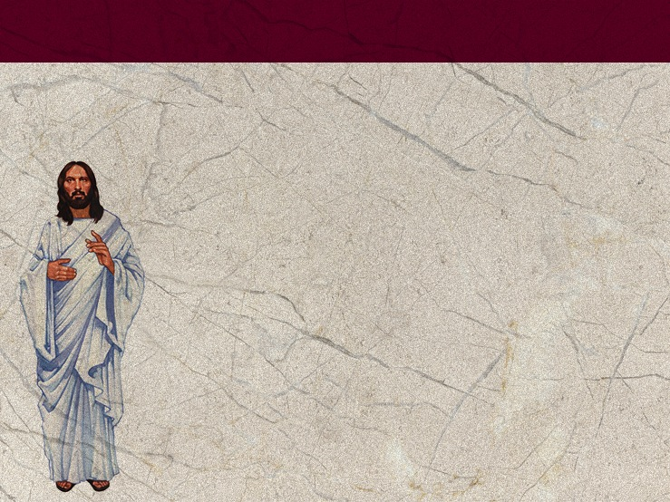
What to Wear
Lydia was a successful business woman who dealt in purple, a colored fabric associated with high rank and great wealth as it was difficult to produce. It was also difficult to produce pure white fabric, so when the Bible refers to Christ as dressed in white linen it was meaningful. Probably Jesus did not wear white clothing here on earth.
Notes:
Lydia was a successful business woman who dealt in purple, a colored fabric associated with high rank and great wealth as it was difficult to produce. It was also difficult to produce pure white fabric, so when the Bible refers to Christ as dressed in white linen it was meaningful. Probably Jesus did not wear white clothing here on earth.

Slide 45
Those New Testament Women
Things were not much different for New Testament women than for Old Testament women; the people of Jerusalem and Judea were stricter in their keeping the law as the rabbis interpreted it than were the people of Galilee, and we see more resistance to Jesus in Judea than in Galilee.
It was still a patriarchal society.
Notes:
Those New Testament Women
Things were not much different for New Testament women than for Old Testament women; the people of Jerusalem and Judea were stricter in their keeping the law as the rabbis interpreted it than were the people of Galilee, and we see more resistance to Jesus in Judea than in Galilee. It was still a patriarchal society.
Their roles were severely limited. The rabbis taught a strict separation of the sexes, and they even viewed conversation with a woman as a serious threat to the man’s spirituality. No wonder the disciples were surprised when they saw Jesus talking to a woman, and a Samaritan woman at that. Abot de Rabbi Nathan wrote that “a man should not speak with a woman in the market, even if she is his wife, much less another woman, because the public may misinterpret it.”
Many women worked alongside their husbands; Priscilla was one of these women, and the fact that she is usually named first indicates that she is given higher honor than is her husband. And just as in the Old Testament, there were business women. But they still didn’t count for much. In the story of Lydia, Paul’s first convert in Europe, in Acts 16, we find a group of women who met down by the river for prayer—there were not enough men to form a synagogue and the women were not counted.

Slide 46

Conclusion
When reading the stories of women in the Bible, it is important to read what is really there and not believe and share what we have heard or seen in a picture. Read carefully.
Notes:
Conclusion
This has been just a glimpse at the culture that covered several thousand years. It was an Oriental culture that is quite foreign to many in the western world. But we can and should continue to try to understand it as it opens Scripture to our understanding. One of the things you can do to help as you begin to appreciate and then understand the women of the Bible is to mark your Bible. Find a color you like, perhaps purple, and mark every reference and time women or something about women is mentioned. You will be amazed and encouraged. There will be women mentioned about whom we know nothing. There are other references to stories we don’t know, but as we begin to get acquainted with these women we will discover that God worked for and through women throughout all time. He made us and them, and He loved and redeemed all of us.
When reading the stories of women in the Bible, it is important to read what is really there and not believe and share what we have heard or seen in a picture. Read carefully.
For instance, in the story of Esther, you will often hear how Esther asked the people to fast and pray, but the Scripture never mentions prayer at all; Esther was in the heathen king’s harem for ten years and no one even knew she was a Jew to say nothing of an observant Jew. Many stories talk of Mary Magdalene’s past as a prostitute; she may have been as a result of her relationship with her uncle Simon the Pharisee, but the Bible only says she had seven demons cast out of her—nothing about prostitution. And remember the pictures about the two disciples on the road to Emmaus? Every picture has two men, but the text only says that there were two disciples, one named and one not. There is a very high likelihood it was a man and his wife—but we get our ideas from paintings.

Slide 47
Conclusion
The Adventist publishing houses have also printed a number of excellent biographical studies of Bible women; while the authors have used their imaginations to fill in much of the stories, they give an excellent understanding of the position of women of Bible times and their cultures.
Notes:
The Adventist publishing houses have also printed a number of excellent biographical studies of Bible women; while the authors have used their imaginations to fill in much of the stories, they give an excellent understanding of the position of women and their cultures.

